Slide 1

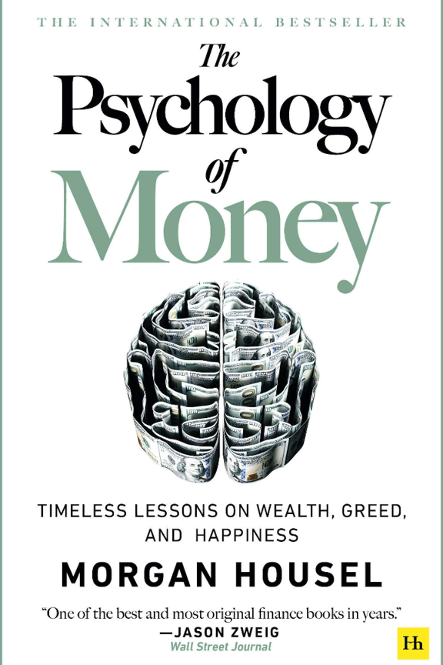
The Psychology of Money
Discover the fascinating relationship between psychology and money in this insightful book that explores how our beliefs and behaviors shape our financial success.

Slide 2
Key Concepts
The Value of Time
Behavioral Biases
Learn how time can be the most valuable asset when it comes to building wealth and making financial decisions.
Uncover the psychological biases that affect our financial choices and discover how to overcome them.
Risk and Uncertainty
The Power of Compounding
Understand our innate aversion to risk and how it influences our financial behavior.
Discover the magic of compound interest and how it can work for or against us in our financial journey.

Slide 3



Money and Behavior
Emotional Attachment
Spending Habits
Financial Stress
Explore the emotional relationship we have with money and how it impacts our decision-making.
Gain insights into common spending patterns and strategies to develop healthier financial habits.
Learn how money-related stress can affect our mental well-being and ways to reduce financial anxiety.

Slide 4
Factors Affecting Financial Success
Mindset Matters
Delayed Gratification
Discover how developing a positive money mindset can lead to financial success. Learn the importance of cultivating healthy financial habits.
Understand the power of delayed gratification in achieving long-term financial goals. Find out how patience can impact wealth accumulation.

Slide 5
Money and Happiness
1
Wealth vs. Happiness
Explore the complex relationship between money and happiness. Debunk common misconceptions and discover the true sources of contentment.
Defining "Enough"
2
Challenge the notion of "more is better" and redefine your concept of financial contentment. Learn to align your financial goals with your personal values.
3
Finding Balance
Discover strategies to strike a balance between financial security and happiness. Explore ways to prioritize experiences over material possessions.

Slide 6
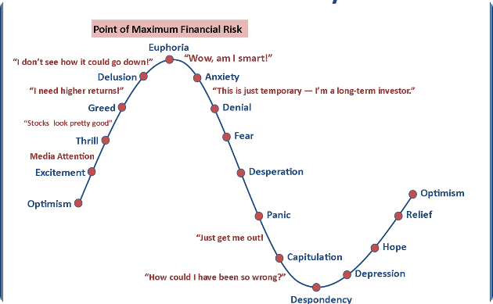

Investment Behavior
Common Mistakes
Long-Term Success
Learn about the common investment mistakes influenced by psychology. Understand the importance of long-term perspective and diversification.
Discover the benefits of adopting a long-term approach to investing. Explore the strategies used by successful investors.

Slide 7
Common Money Mistakes
1
Impulse Buying
2
Lack of Saving
3
Overconfidence Bias
Examine the reasons behind impulsive spending and learn techniques to avoid buyer's remorse.
Discover why many struggle to save money and strategies to build a stable financial future.
Understand how overconfidence can lead to poor financial choices and learn how to stay grounded.

Slide 8
Effective Money Management
1
Budgeting Basics
Learn how to create and stick to a practical budget that aligns with your financial goals.
Debt Management
2
Discover strategies for reducing and managing debt to achieve greater financial freedom.
3
Investing Wisely
Explore different investment strategies and how to make informed decisions to grow your wealth.

Slide 9
Benefits of Reading the Book
Expand Financial Literacy
Gain Valuable Insights
Change Your Money Mindset
Discover real-life case studies and stories that provide practical wisdom for managing your finances.
Enhance your understanding of money psychology and improve your financial decision-making skills.
Shift your perspective on money and develop a healthier relationship with your finances.

Slide 10
Reader Reviews and Opinions
⭐️⭐️⭐️⭐️⭐️
⭐️⭐️⭐️⭐️
⭐️⭐️⭐️⭐️
"This book changed my financial outlook entirely. A must-read for anyone seeking financial success!"
"Thought-provoking and insightful. It offers a fresh perspective on the psychology of money."
"Engaging and relatable. The author's anecdotes make complex topics easy to understand and apply."

Slide 11

Why You Should Read This Book
1
Unlock Financial Success
2
Improve Your Financial Decision-Making
Discover the secrets to achieving financial security and building wealth.
Arm yourself with psychological insights to make smarter financial choices.
3
Transform Your Money Mindset
Reframe your beliefs about money and develop a positive relationship with your finances.

Slide 12

Conclusion
Recap the key insights discussed in "The Psychology of Money" presentation. Reflect on the impact of psychological factors on financial decision-making.
What People Say
"A game-changer for anyone looking to understand their relationship with money." - John Doe, Financial Analyst
"This book provides valuable insights into the emotional aspects of wealth management." - Jane Smith, Investor

Slide 13

Contributors
Thank you to everyone who contributed to this presentation. Please write your name below:

